Slide 1
Support vector machines
Hung-Hsuan Chen
Many are taken from Prof. C.-J. Lin’s and J. Leskovec’s slides

Slide 2
(Linear) support vector classification
Data point i: x_{i} = (x_{i1}, x_{i2}, …, x_{id})
Class label of i: y_{i}
Two classes
Class 1: y_{i} = 1
Class 2: y_{i} = -1
Find a hyperplane to separate the data points

Slide 3
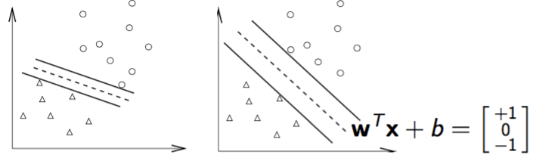
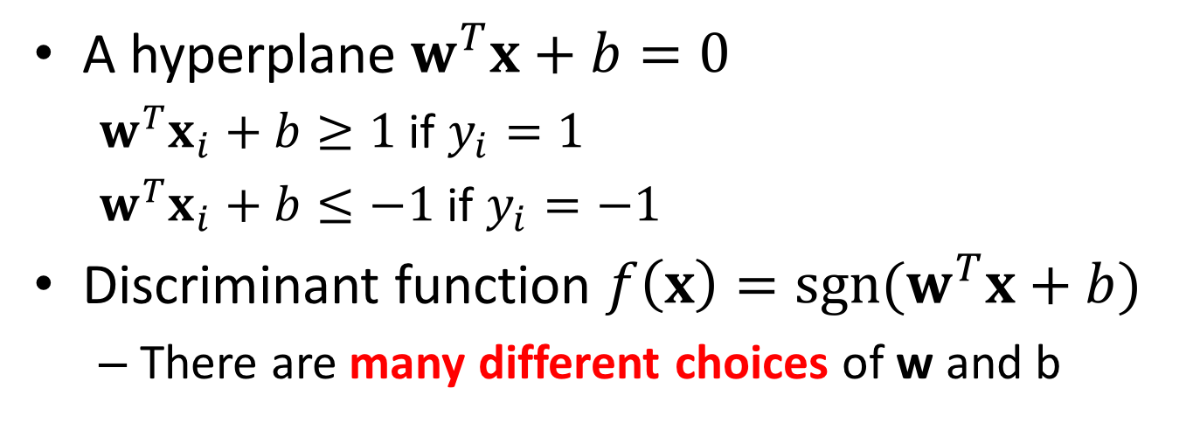
Assume the dataset is linearly separable
A hyperplane $w^{T}x+b=0$
$w^{T}x_{i}+b≥1$ if $y_{i}=1$
$w^{T}x_{i}+b≤−1$ if $y_{i}=−1$
Discriminant function ${f\left(x\right)=sgn(w}^{T}x+b)$
There are many different choices of w and b

Slide 4
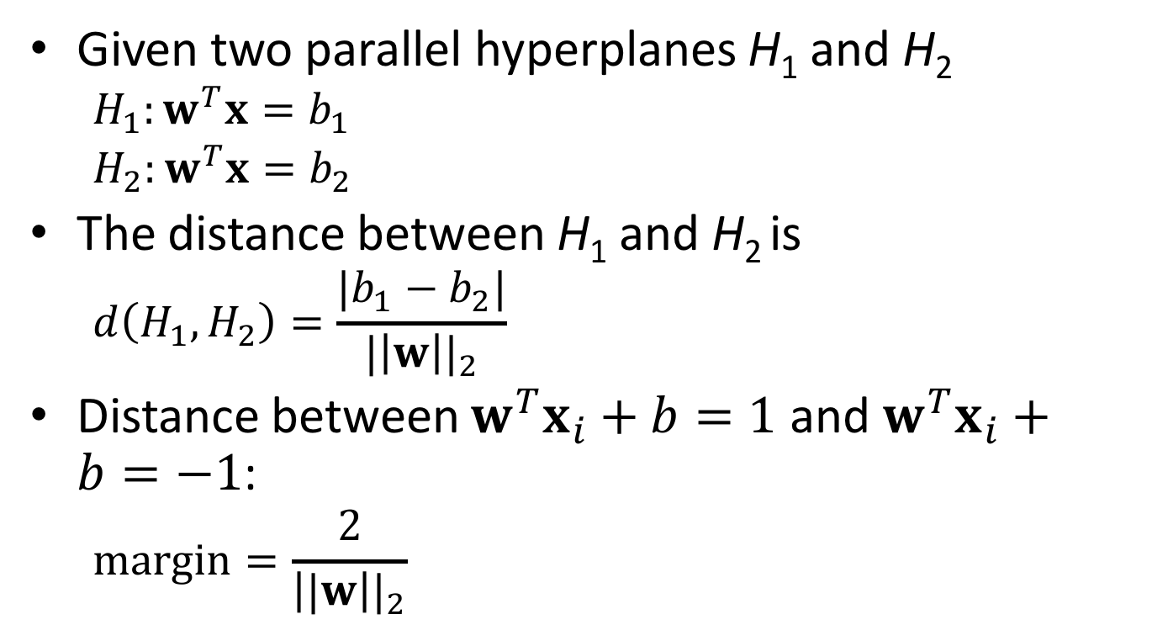
Margin distance
Given two parallel hyperplanes H₁ and H₂
$$H_{1}:w^{T}x=b_{1}$$
$H_{2}:w^{T}x=b_{2}$
The distance between H₁ and H₂ is
$$d\left(H_{1},H_{2}\right)=\frac{|b_{1}−b_{2}|}{{|\left|w\right||}_{2}}$$
Distance between $w^{T}x_{i}+b=1$ and $w^{T}x_{i}+b=−1$:
$$margin=\frac{2}{{\left||w\right||}_{2}}$$

Slide 5
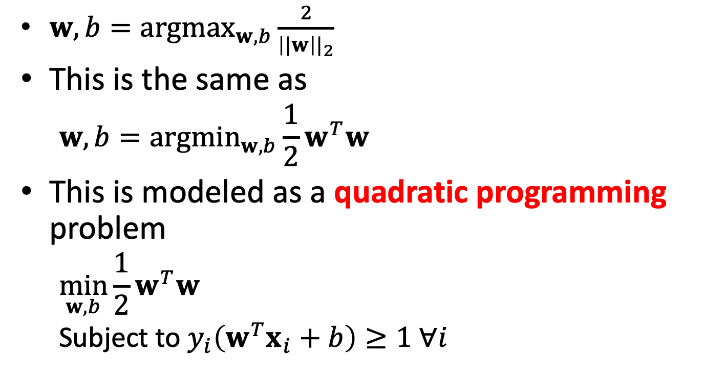
Maximum margin
$w,b={argmax}_{w,b}\frac{2}{{\left||w\right||}_{2}}$
This is the same as
$$w,b={argmin}_{w,b}{\frac{1}{2}w}^{T}w$$
This is modeled as a quadratic programming problem
$$\min_{w,b}{{\frac{1}{2}w}^{T}w}$$
Subject to $y_{i}\left(w^{T}x_{i}+b\right)≥1 ∀i$

Slide 6
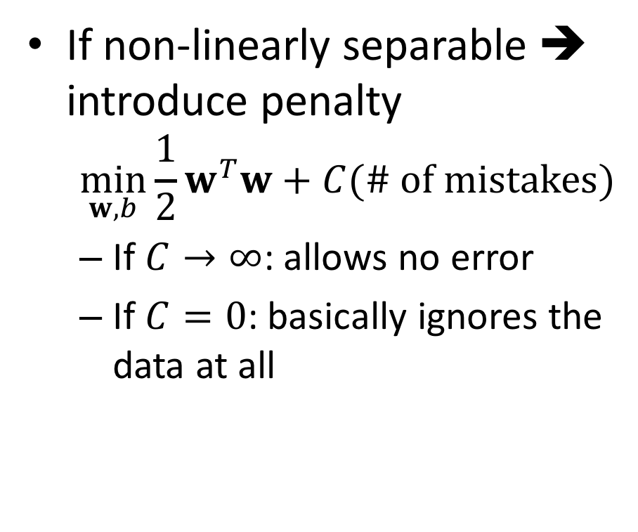
Non-linearly separable dataset
If non-linearly separable ➔ introduce penalty
$$\min_{w,b}{{\frac{1}{2}w}^{T}w}+C(\# of mistakes)$$
If $C→∞$: allows no error
If $C=0$: basically ignores the data at all
small C
+
“good” C
+
+
+
+
big C
+
-
-
+
+
-
-
-
-
(0,0)

Slide 7
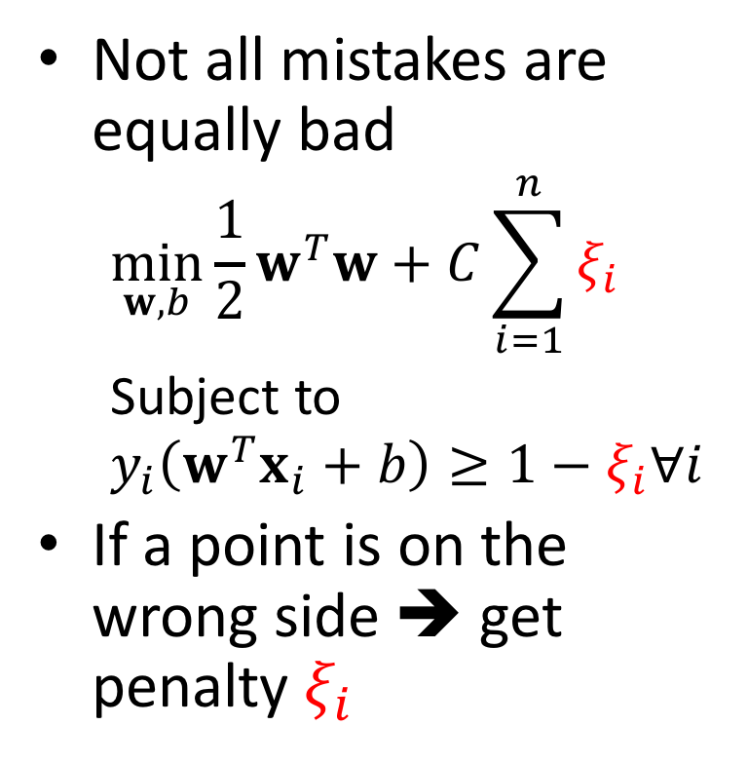
Introduce slack variable
Not all mistakes are equally bad
$$\min_{w,b}{{\frac{1}{2}w}^{T}w}+C\sum_{i=1}^{n}{ξ_{i}}$$
Subject to
$$y_{i}\left(w^{T}x_{i}+b\right)≥1−ξ_{i}∀i$$
If a point is on the wrong side ➔ get penalty $ξ_{i}$
+
L: w⋅x+b=0
+
+
-
+
ξ_{i}
+
+
ξ_{j}
-
-
+
+
-
-
-
For each data point x:
If d(x, L) ≥ 1 and at the right side: don’t care
Else: pay linear penalty

Slide 8
Soft margin classification
Why soft margin
The training data may not be linearly separable
Even if the training data is linearly separable, allowing some error may increase the margin
Essentially, there are two objectives (which may against each other)
Minimize the training error
Prevent error
Maximize the margin
Prevent overfitting (allow some error)
ξ_{i}
ξ_{j}

Slide 9
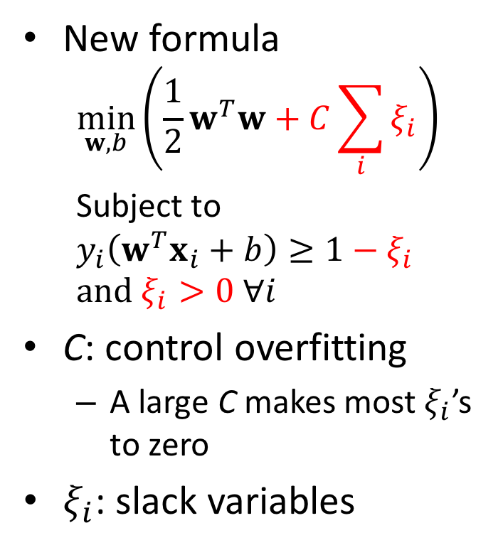
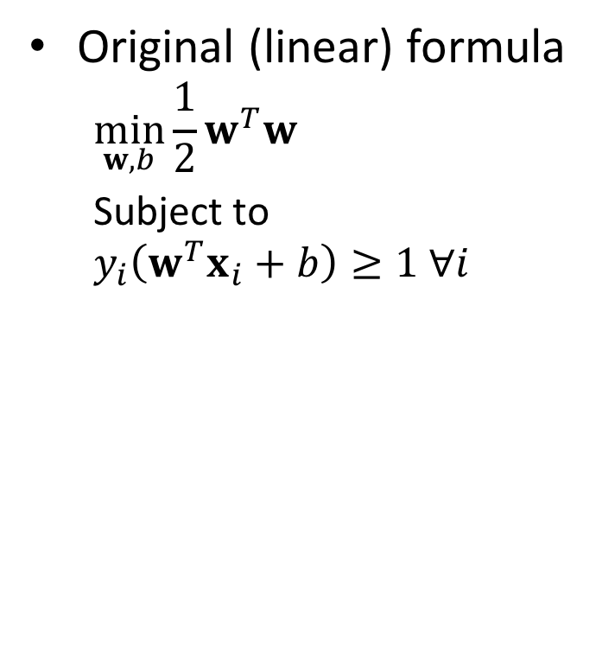
Soft margin classification formula
Original (linear) formula
$$\min_{w,b}{{\frac{1}{2}w}^{T}w}$$
Subject to
$$y_{i}\left(w^{T}x_{i}+b\right)≥1 ∀i$$
New formula
$$\min_{w,b}\left({\frac{1}{2}w}^{T}w+C\sum_{i}{ξ_{i}}\right)$$
Subject to
$$y_{i}\left(w^{T}x_{i}+b\right)≥1−ξ_{i}$$
$$and ξ_{i}>0 ∀i$$
C: control overfitting
A large C makes most $ξ_{i}$’s to zero
$ξ_{i}$: slack variables

Slide 10
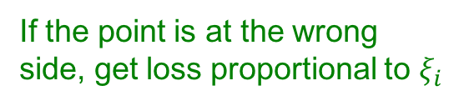
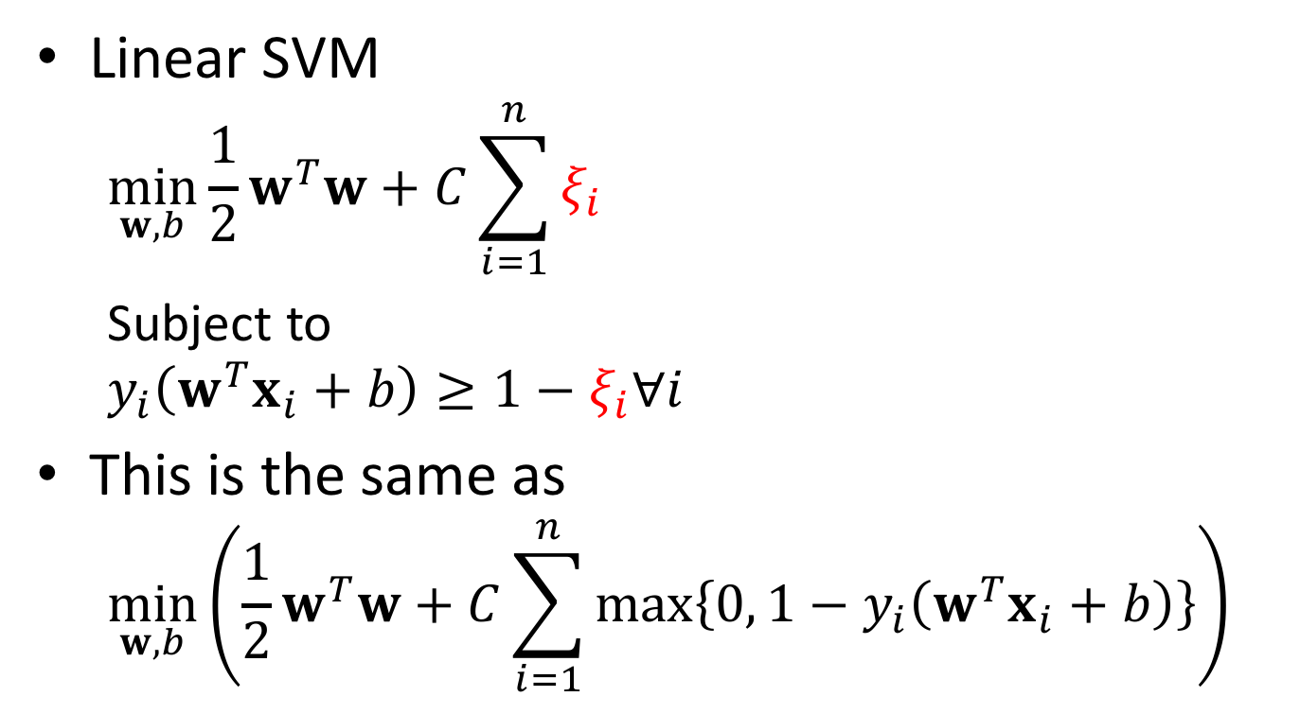
Linear SVM with soft margin
Linear SVM
$$\min_{w,b}{{\frac{1}{2}w}^{T}w}+C\sum_{i=1}^{n}{ξ_{i}}$$
Subject to
$$y_{i}\left(w^{T}x_{i}+b\right)≥1−ξ_{i}∀i$$
This is the same as
$$\min_{w,b}\left({\frac{1}{2}w}^{T}w+C\sum_{i=1}^{n}{\max\left\{0, 1−y_{i}\left(w^{T}x_{i}+b\right)\right\}}\right)$$
If the point is at the wrong side, get loss proportional to $ξ_{i}$
Margin inverse
Regularization parameter
Empirical loss L (how well we fit training data)

Slide 11
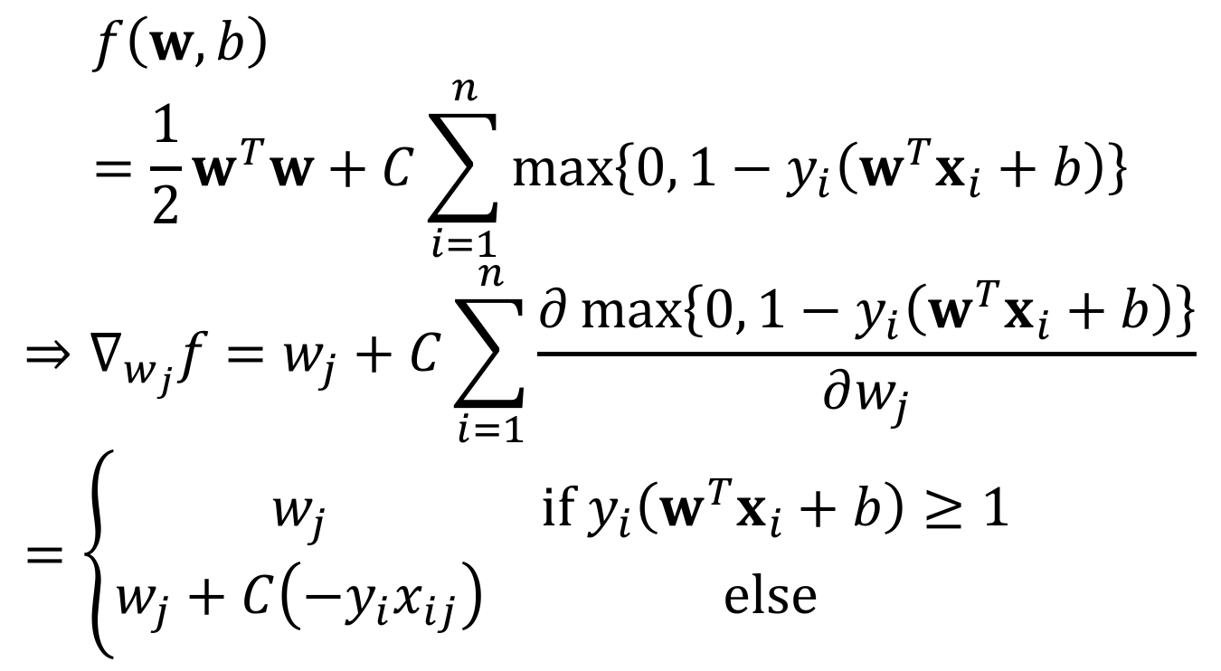
Derivatives
$$f\left(w,b\right)={\frac{1}{2}w}^{T}w+C\sum_{i=1}^{n}{\max\left\{0, 1−y_{i}\left(w^{T}x_{i}+b\right)\right\}}$$
$$⇒∇_{w_{j}}f=w_{j}+C\sum_{i=1}^{n}{\frac{∂\max\left\{0, 1−y_{i}\left(w^{T}x_{i}+b\right)\right\}}{∂w_{j}}}=\left\{\begin{matrix}w_{j} & if y_{i}\left(w^{T}x_{i}+b\right)≥1 \\ w_{j}+C\left(−y_{i}x_{ij}\right) & else \end{matrix}\right.$$

Slide 12

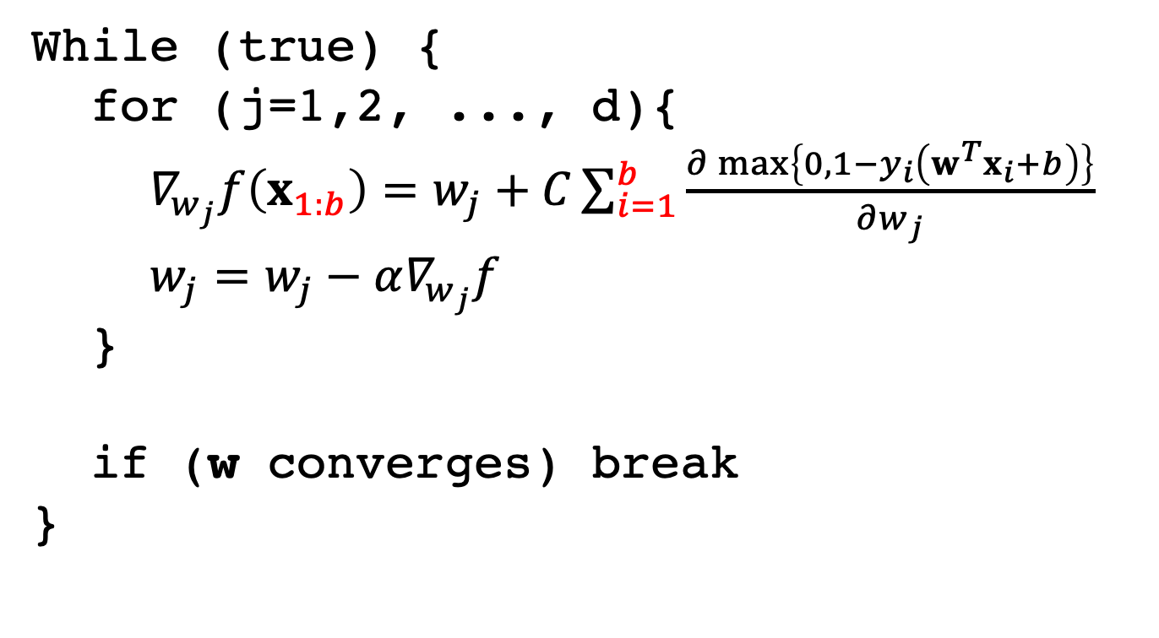
Solve Linear SVM by GD
While (true) {
for (j=1,2, ..., d){
$∇_{w_{j}}f\left(x_{1:b}\right)=w_{j}+C\sum_{i=1}^{b}{\frac{∂\max\left\{0, 1−y_{i}\left(w^{T}x_{i}+b\right)\right\}}{∂w_{j}}}$
$w_{j}=w_{j}−α∇_{w_{j}}f$
}
if (w converges) break
}
Note: $b$ is batch size

Slide 13
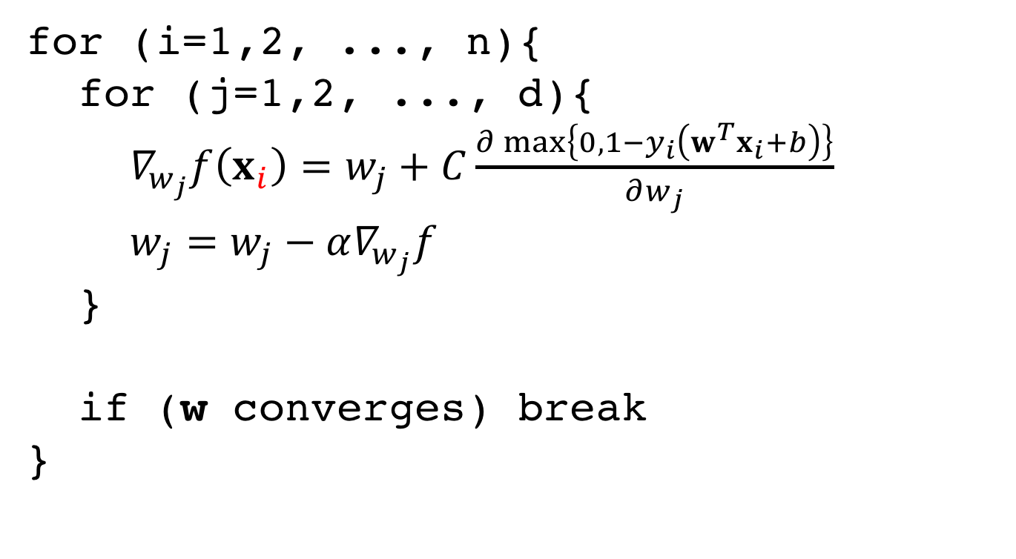
Solve Linear SVM by SGD
for (i=1,2, ..., n){
for (j=1,2, ..., d){
$∇_{w_{j}}f\left(x_{i}\right)=w_{j}+C\frac{∂\max\left\{0, 1−y_{i}\left(w^{T}x_{i}+b\right)\right\}}{∂w_{j}}$
$w_{j}=w_{j}−α∇_{w_{j}}f$
}
if (w converges) break
}

Slide 14
Detour
Lagrange multiplier
KKT condition
Math caution!
If you get lost, I hope you at least understand the linear SVM

Slide 15
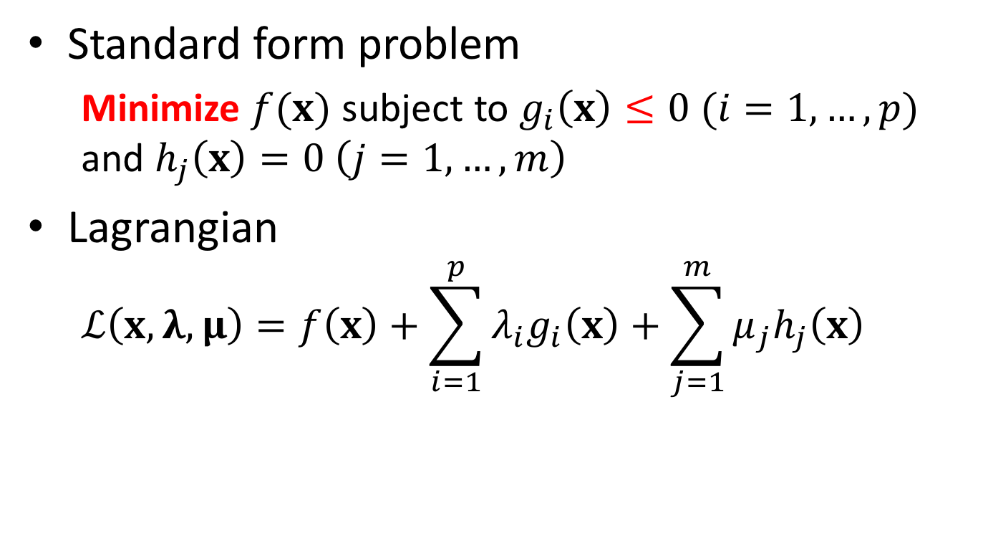
Generalized Lagrange multiplier
Standard form problem
Minimize $f(x)$ subject to $g_{i}\left(x\right)≤0 (i=1,…,p)$ and $h_{j}\left(x\right)=0 \left(j=1,…,m\right)$
Lagrangian
$$ℒ\left(x,λ,μ\right)=f\left(x\right)+\sum_{i=1}^{p}{λ_{i}g_{i}\left(x\right)}+\sum_{j=1}^{m}{μ_{j}h_{j}\left(x\right)}$$

Slide 16
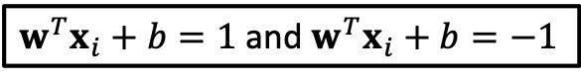
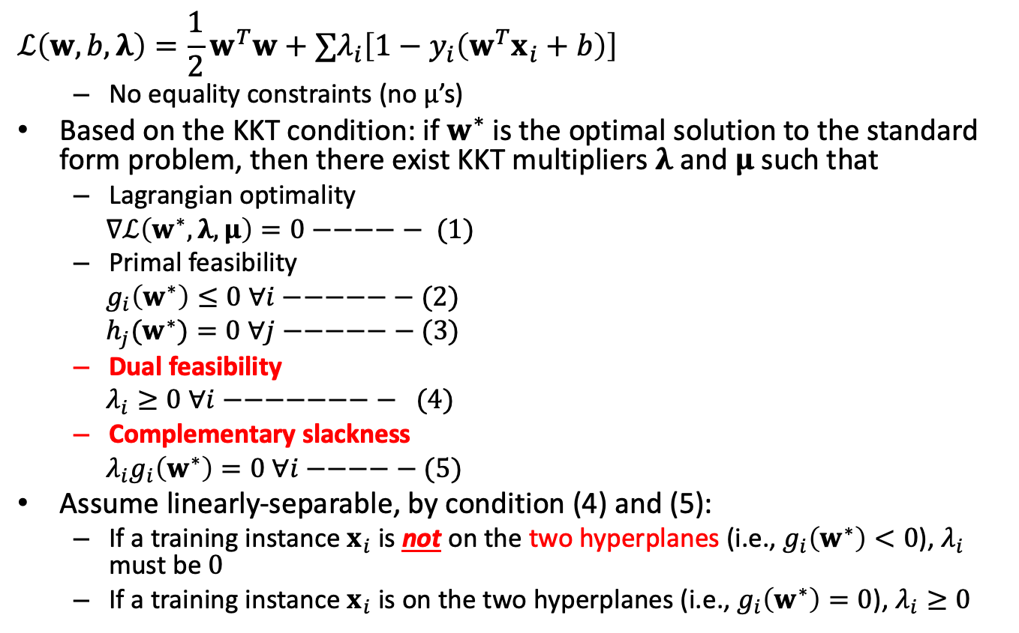
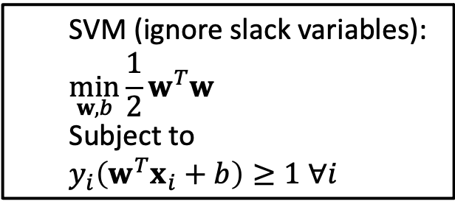
The characteristic of the solution
SVM (ignore slack variables):
$$\min_{w,b}{{\frac{1}{2}w}^{T}w}$$
Subject to
$$y_{i}\left(w^{T}x_{i}+b\right)≥1 ∀i$$
$$ℒ\left(w,b,λ\right)=\frac{1}{2}w^{T}w+∑λ_{i}\left[1−y_{i}\left(w^{T}x_{i}+b\right)\right]$$
No equality constraints (no $μ$’s)
Based on the KKT condition: if $w^{∗}$ is the optimal solution to the standard form problem, then there exist KKT multipliers $λ$ and $μ$ such that
Lagrangian optimality
$∇ℒ\left(w^{∗},λ,μ\right)=0−−−−− (1)$
Primal feasibility
$g_{i}\left(w^{∗}\right)≤0 ∀i−−−−−− (2)$
${h_{j}(w}^{∗})=0 ∀j−−−−−− (3)$
Dual feasibility
$λ_{i}≥0 ∀i−−−−−−−− (4)$
Complementary slackness
$λ_{i}g_{i}\left(w^{∗}\right)=0 ∀i−−−−− (5)$
Assume linearly-separable, by condition (4) and (5):
If a training instance $x_{i}$ is not on the two hyperplanes (i.e., $g_{i}\left(w^{∗}\right)<0$), $λ_{i}$ must be $0$
If a training instance $x_{i}$ is on the two hyperplanes (i.e., $g_{i}\left(w^{∗}\right)=0$), $λ_{i}≥0$
$w^{T}x_{i}+b=1$ and $w^{T}x_{i}+b=−1$

Slide 17
Map features to higher dimensional
Transform the data into a higher dimension feature space so that linear separation is possible
Higher dimensional (could be infinite) feature space
$φ\left(x_{i}\right)={\left[φ_{1}\left(x_{i}\right),φ_{2}\left(x_{i}\right),…\right]}^{T}$

Slide 18
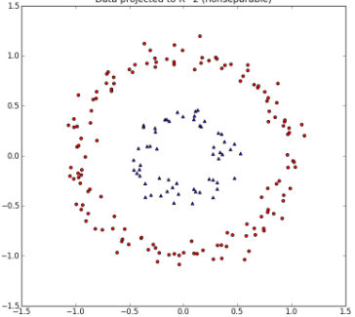
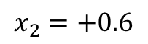
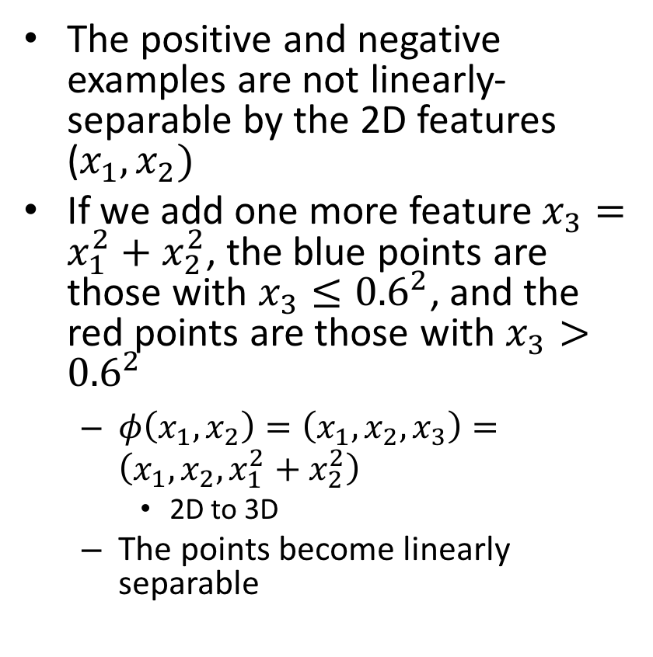
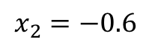
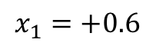
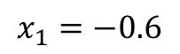
Example
The positive and negative examples are not linearly- separable by the 2D features ($x_{1}, x_{2})$
If we add one more feature $x_{3}=x_{1}^{2}+x_{2}^{2}$, the blue points are those with $x_{3}≤{0.6}^{2}$, and the red points are those with $x_{3}>{0.6}^{2}$
$φ\left(x_{1},x_{2}\right)=\left(x_{1},x_{2},x_{3}\right)=\left(x_{1},x_{2},x_{1}^{2}+x_{2}^{2}\right)$
2D to 3D
The points become linearly separable
$$x_{2}=+0.6$$
$$x_{2}=−0.6$$
$$x_{1}=−0.6$$
$$x_{1}=+0.6$$

Slide 19
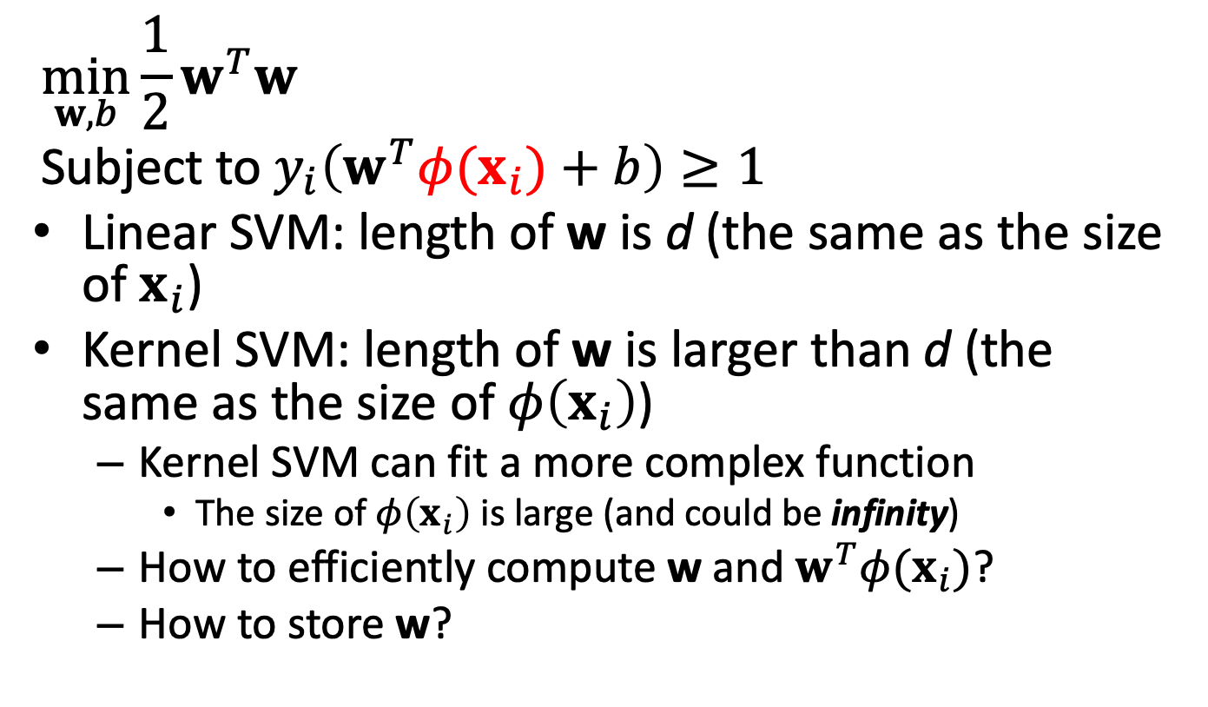
Kernel SVM
Here we ignore the slack variables for simplicity
$$\min_{w,b}{{\frac{1}{2}w}^{T}w}$$
Subject to $y_{i}\left(w^{T}φ(x_{i})+b\right)≥1$
Linear SVM: length of w is d (the same as the size of $x_{i}$)
Kernel SVM: length of w is larger than d (the same as the size of $φ\left(x_{i}\right)$)
Kernel SVM can fit a more complex function
The size of $φ\left(x_{i}\right)$ is large (and could be infinity)
How to efficiently compute w and $w^{T}φ(x_{i})$?
How to store w?

Slide 20
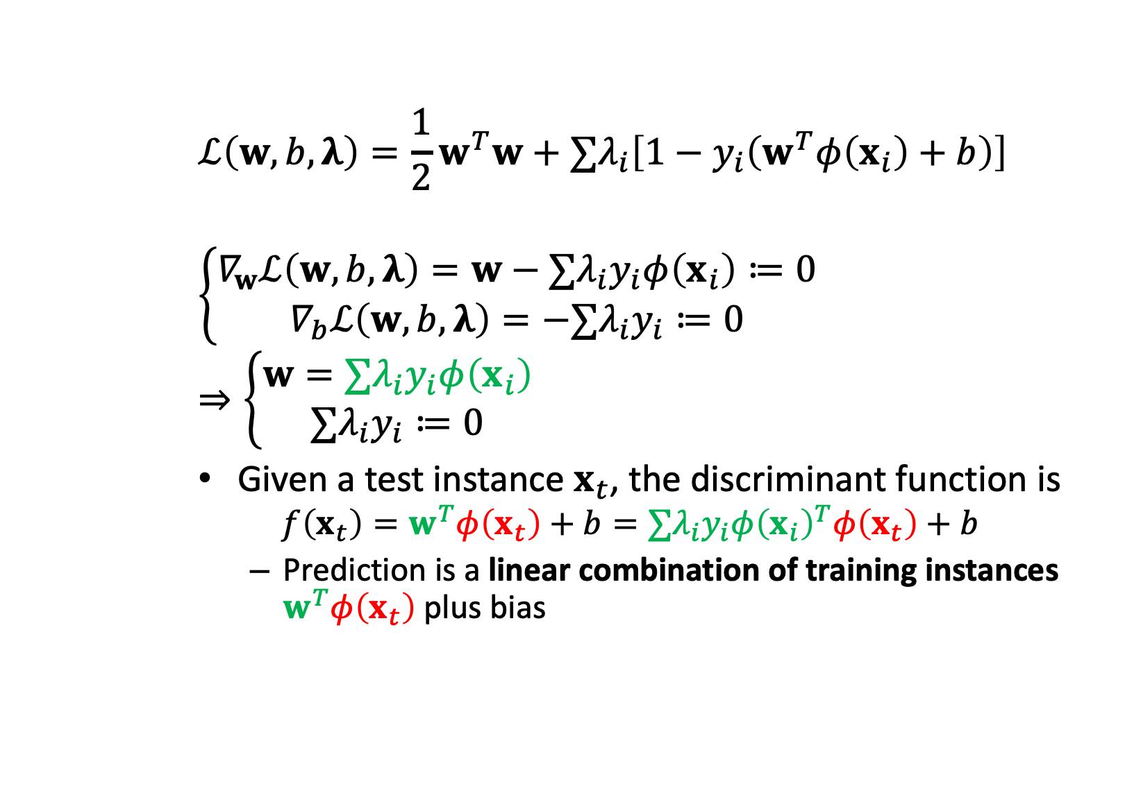
Lagrangian of kernel SVM
$$ℒ\left(w,b,λ\right)={\frac{1}{2}w}^{T}w+∑λ_{i}\left[1−y_{i}\left(w^{T}φ\left(x_{i}\right)+b\right)\right]$$
$$\left\{\begin{aligned}∇_{w}ℒ\left(w,b,λ\right)=w−∑λ_{i}y_{i}φ\left(x_{i}\right)≔0 \\ ∇_{b}ℒ\left(w,b,λ\right)=−∑λ_{i}y_{i}≔0\end{aligned}\right.$$
$$⇒\left\{\begin{aligned}w=∑λ_{i}y_{i}φ\left(x_{i}\right) \\ ∑λ_{i}y_{i}≔0\end{aligned}\right.$$
Given a test instance $x_{t}$, the discriminant function is
$$f\left(x_{t}\right)=w^{T}φ\left(x_{t}\right)+b=∑λ_{i}y_{i}φ{\left(x_{i}\right)}^{T}φ\left(x_{t}\right)+b$$
Prediction is a linear combination of training instances $w^{T}φ\left(x_{t}\right)$plus bias

Slide 21
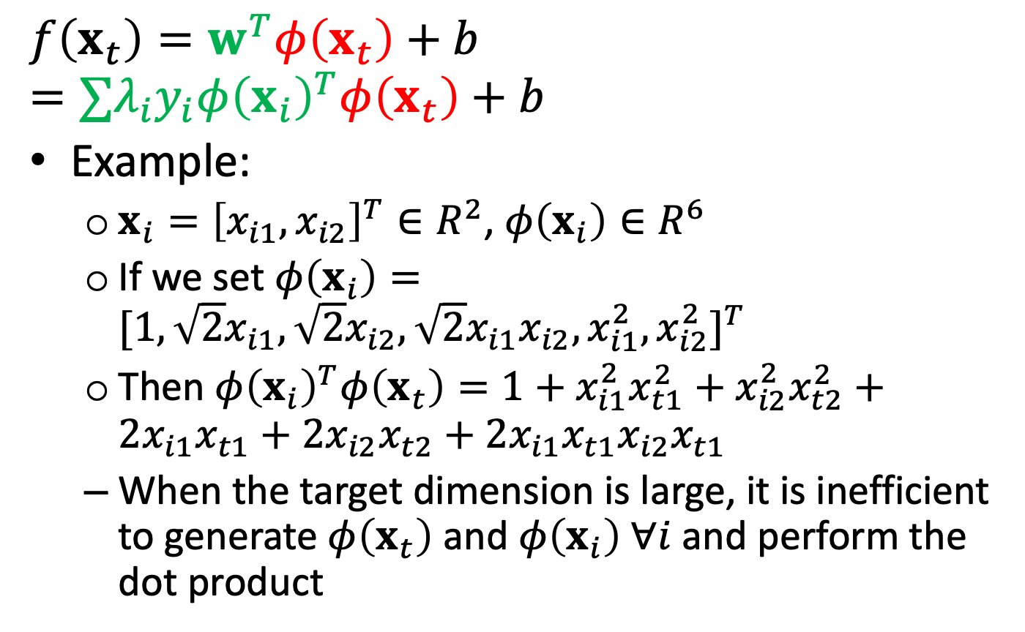
High dimensional mapping example
$$f\left(x_{t}\right)=w^{T}φ\left(x_{t}\right)+b=∑λ_{i}y_{i}φ{\left(x_{i}\right)}^{T}φ\left(x_{t}\right)+b$$
Example:
$x_{i}={\left[x_{i1},x_{i2}\right]}^{T}∈R^{2}$, $φ\left(x_{i}\right)∈R^{6}$
If we set $φ\left(x_{i}\right)=[1,\sqrt{2}x_{i1},\sqrt{2}x_{i2},\sqrt{2}x_{i1}x_{i2}, x_{i1}^{2},x_{i2}^{2}]^{T}$
Then $φ{\left(x_{i}\right)}^{T}φ\left(x_{t}\right)=1+x_{i1}^{2}x_{t1}^{2}+x_{i2}^{2}x_{t2}^{2}+2x_{i1}x_{t1}+2x_{i2}x_{t2}+2x_{i1}x_{t1}x_{i2}x_{t1}$
When the target dimension is large, it is inefficient to generate $φ\left(x_{t}\right)$ and $φ\left(x_{i}\right) ∀i$ and perform the dot product

Slide 22
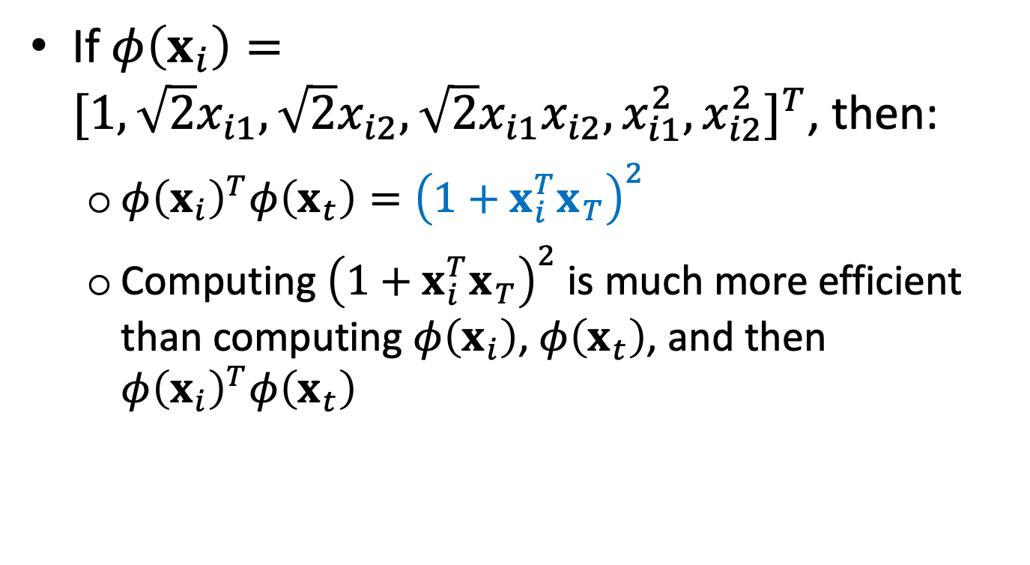
Kernel trick example
If $φ\left(x_{i}\right)=[1,\sqrt{2}x_{i1},\sqrt{2}x_{i2},\sqrt{2}x_{i1}x_{i2}, x_{i1}^{2},x_{i2}^{2}]^{T}$, then:
$φ{\left(x_{i}\right)}^{T}φ\left(x_{t}\right)={\left(1+x_{i}^{T}x_{T}\right)}^{2}$
Computing ${\left(1+x_{i}^{T}x_{T}\right)}^{2}$ is much more efficient than computing $φ\left(x_{i}\right)$, $φ\left(x_{t}\right)$, and then $φ{\left(x_{i}\right)}^{T}φ\left(x_{t}\right)$

Slide 23
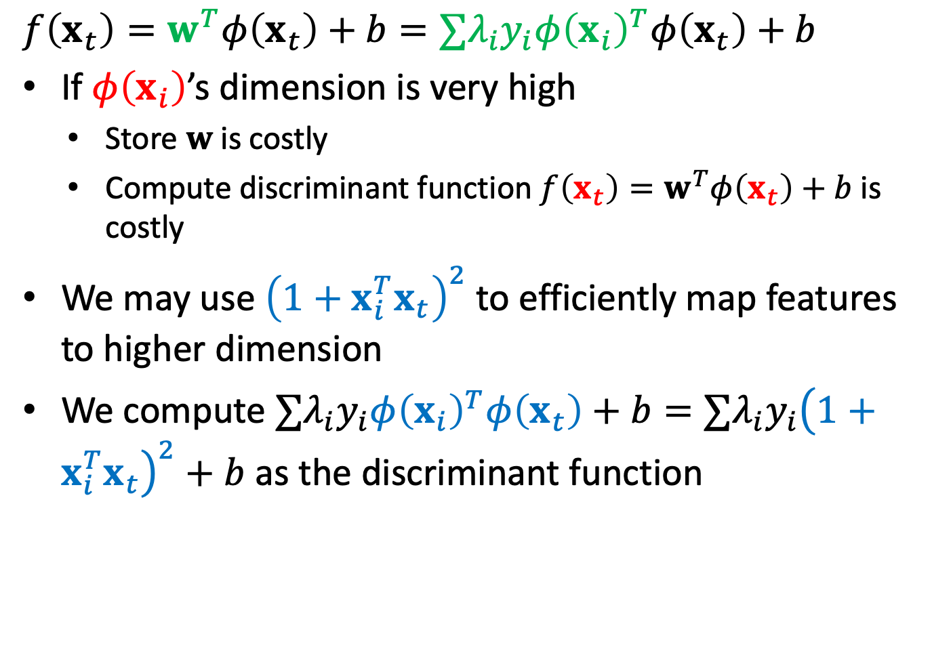
Kernel trick example
$$f\left(x_{t}\right)=w^{T}φ\left(x_{t}\right)+b=∑λ_{i}y_{i}φ{\left(x_{i}\right)}^{T}φ\left(x_{t}\right)+b$$
If $φ\left(x_{i}\right)$’s dimension is very high
Store $w$ is costly
Compute discriminant function $f\left(x_{t}\right)=w^{T}φ\left(x_{t}\right)+b$ is costly
We may use ${\left(1+x_{i}^{T}x_{t}\right)}^{2}$ to efficiently map features to higher dimension
We compute $∑λ_{i}y_{i}φ{\left(x_{i}\right)}^{T}φ\left(x_{t}\right)+b=∑λ_{i}y_{i}{\left(1+x_{i}^{T}x_{t}\right)}^{2}+b$ as the discriminant function

Slide 24
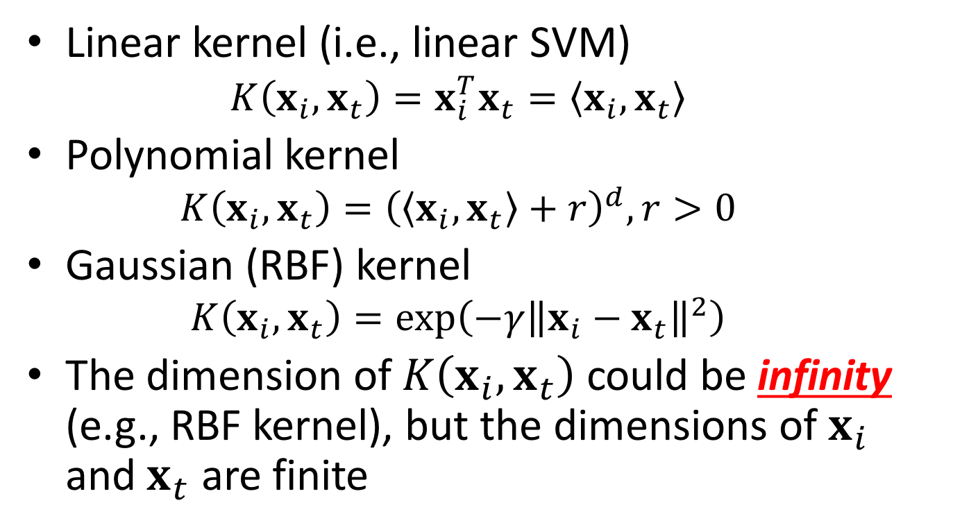
Popular kernels
Linear kernel (i.e., linear SVM)
$$K\left(x_{i},x_{t}\right)=x_{i}^{T}x_{t}=\left\langle x_{i},x_{t}\right\rangle$$
Polynomial kernel
$$K\left(x_{i},x_{t}\right)={\left(\left\langle x_{i},x_{t}\right\rangle +r\right)}^{d}, r>0$$
Gaussian (RBF) kernel
$$K\left(x_{i},x_{t}\right)=\exp\left(−γ{\left\|x_{i}−x_{t}\right\|}^{2}\right)$$
The dimension of $K\left(x_{i},x_{t}\right)$ could be infinity (e.g., RBF kernel), but the dimensions of $x_{i}$ and $x_{t}$ are finite

Slide 25
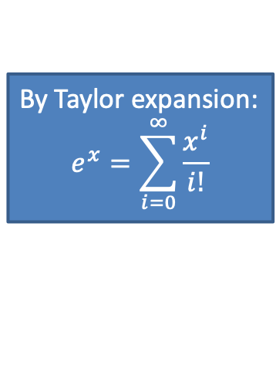
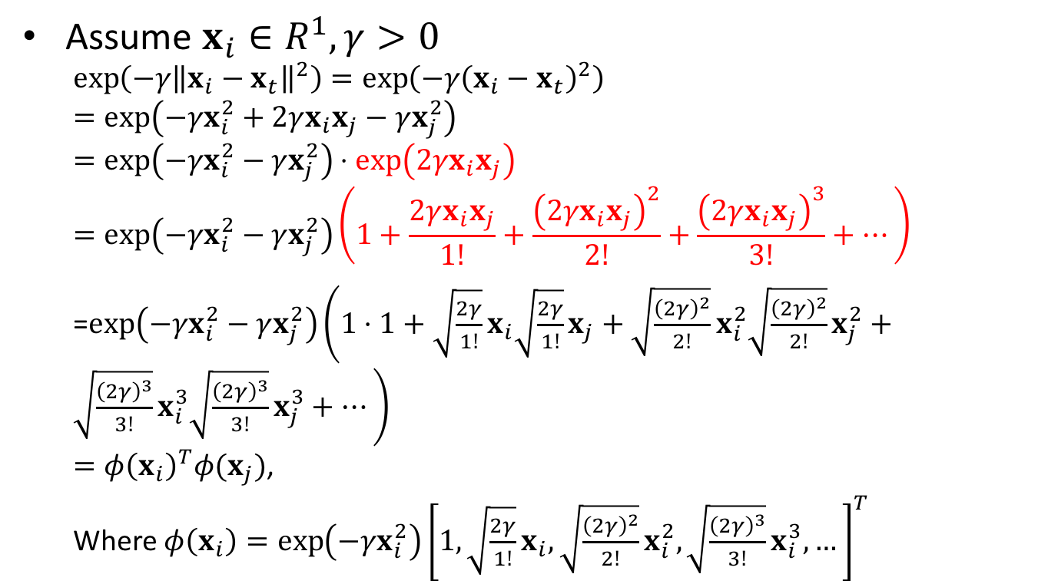
Mapping to infinite dimensional
By Taylor expansion:
$$e^{x}=\sum_{i=0}^{∞}{\frac{x^{i}}{i!}}$$
Assume $x_{i}∈R^{1}, γ>0$
$$\exp\left(−γ{\left\|x_{i}−x_{t}\right\|}^{2}\right)=\exp\left(−γ{\left(x_{i}−x_{t}\right)}^{2}\right) \\ =\exp\left(−γx_{i}^{2}+2γx_{i}x_{j}−γx_{j}^{2}\right)$$
$$=\exp\left(−γx_{i}^{2}−γx_{j}^{2}\right)⋅\exp\left(2γx_{i}x_{j}\right) \\ =\exp\left(−γx_{i}^{2}−γx_{j}^{2}\right)\left(1+\frac{2γx_{i}x_{j}}{1!}+\frac{{\left(2γx_{i}x_{j}\right)}^{2}}{2!}+\frac{{\left(2γx_{i}x_{j}\right)}^{3}}{3!}+…\right)$$ =$\exp\left(−γx_{i}^{2}−γx_{j}^{2}\right)\left(1⋅1+\sqrt{\frac{2γ}{1!}}x_{i}\sqrt{\frac{2γ}{1!}}x_{j}+\sqrt{\frac{{\left(2γ\right)}^{2}}{2!}}x_{i}^{2}\sqrt{\frac{{\left(2γ\right)}^{2}}{2!}}x_{j}^{2}+\sqrt{\frac{{\left(2γ\right)}^{3}}{3!}}x_{i}^{3}\sqrt{\frac{{\left(2γ\right)}^{3}}{3!}}x_{j}^{3}+…\right)$ $=φ{\left(x_{i}\right)}^{T}φ(x_{j})$,
Where $φ\left(x_{i}\right)=\exp\left(−γx_{i}^{2}\right){\left[1,\sqrt{\frac{2γ}{1!}}x_{i}, \sqrt{\frac{{\left(2γ\right)}^{2}}{2!}}x_{i}^{2}, \sqrt{\frac{{\left(2γ\right)}^{3}}{3!}}x_{i}^{3}, …\right]}^{T}$

Slide 26
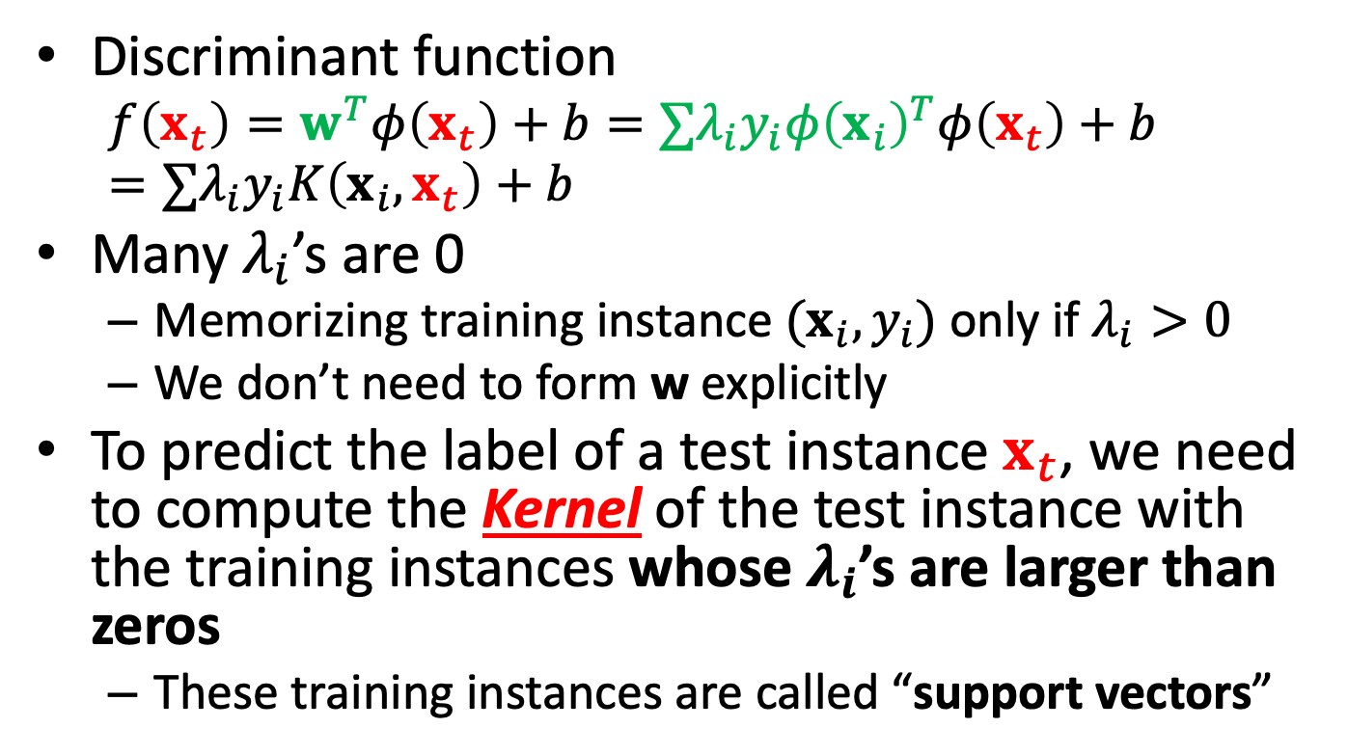
Characteristics of the solution
Discriminant function
$$f\left(x_{t}\right)=w^{T}φ\left(x_{t}\right)+b=∑λ_{i}y_{i}φ{\left(x_{i}\right)}^{T}φ\left(x_{t}\right)+b=∑λ_{i}y_{i}K\left(x_{i},x_{t}\right)+b$$
Many $λ_{i}$’s are 0
Memorizing training instance $(x_{i},y_{i})$ only if $λ_{i}>0$
We don’t need to form w explicitly
To predict the label of a test instance $x_{t}$, we need to compute the Kernel of the test instance with the training instances whose $λ_{i}$’s are larger than zeros
These training instances are called “support vectors”

Slide 27
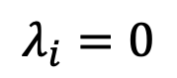
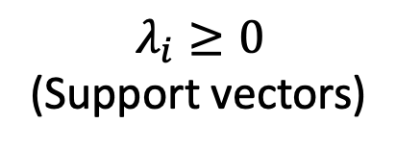
Visualizing “support vectors”
$$λ_{i}=0$$
$$λ_{i}≥0$$
(Support vectors)

Slide 28
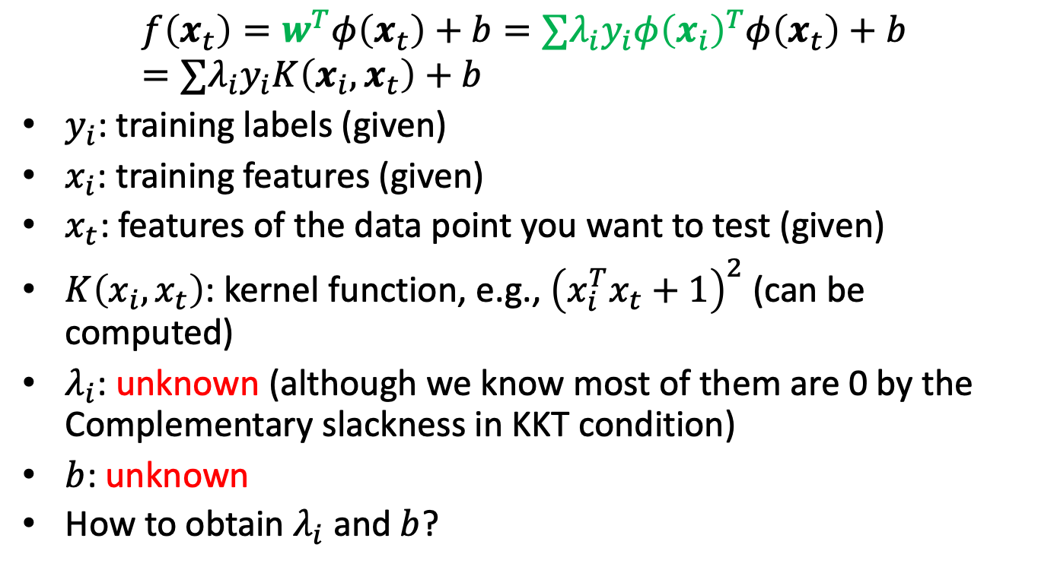
How to obtain the variables in the discriminant function?
$$f\left(x_{t}\right)=w^{T}φ\left(x_{t}\right)+b=∑λ_{i}y_{i}φ{\left(x_{i}\right)}^{T}φ\left(x_{t}\right)+b=∑λ_{i}y_{i}K\left(x_{i},x_{t}\right)+b$$
$y_{i}$: training labels (given)
$x_{i}$: training features (given)
$x_{t}$: features of the data point you want to test (given)
$K\left(x_{i},x_{t}\right)$: kernel function, e.g., ${\left(x_{i}^{T}x_{t}+1\right)}^{2}$ (can be computed)
$λ_{i}$: unknown (although we know most of them are 0 by the Complementary slackness in KKT condition)
$b$: unknown
How to obtain $λ_{i}$ and $b$?

Slide 29
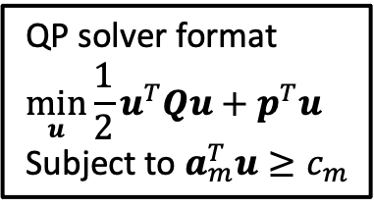
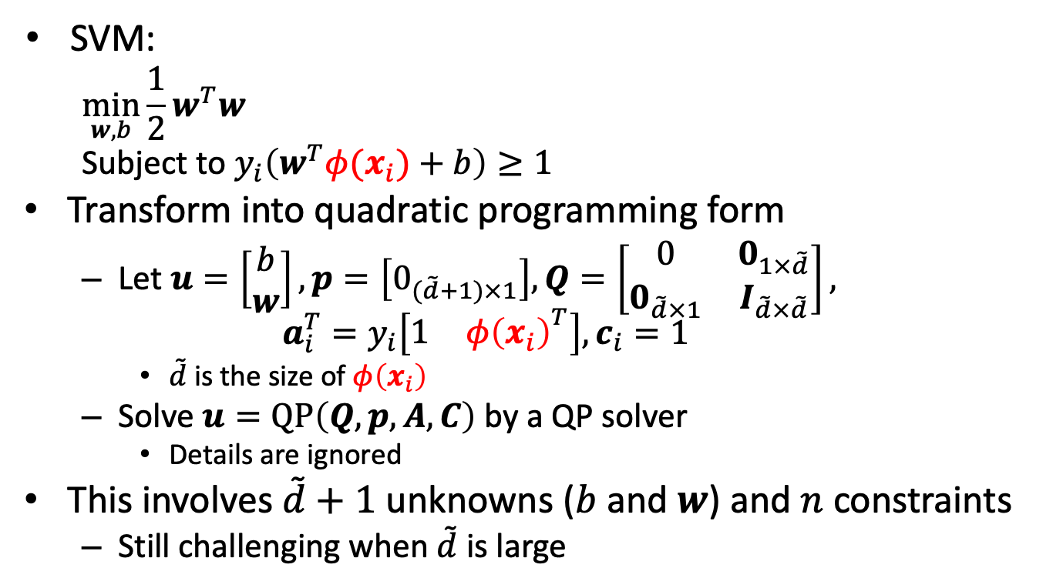
Quadratic programming
QP solver format
$$\min_{u}{{\frac{1}{2}u}^{T}Qu+p^{T}u}$$
Subject to $a_{m}^{T}u≥c_{m}$
SVM:
$$\min_{w,b}{{\frac{1}{2}w}^{T}w}$$
Subject to $y_{i}\left(w^{T}φ(x_{i})+b\right)≥1$
Transform into quadratic programming form
Let $u=\left[\begin{aligned}b \\ w\end{aligned}\right], p=\left[0_{(\tilde{d}+1)×1}\right],Q=\left[\begin{matrix}0 & 0_{1×\tilde{d}} \\ 0_{\tilde{d}×1} & I_{\tilde{d}×\tilde{d}}\end{matrix}\right],$ $a_{i}^{T}=y_{i}\left[{\begin{matrix}1 & φ\left(x_{i}\right)\end{matrix}}^{T}\right], c_{i}=1$
$\tilde{d}$ is the size of $φ\left(x_{i}\right)$
Solve $u=QP\left(Q,p,A,C\right)$ by a QP solver
Details are ignored
This involves $\tilde{d}+1$ unknowns ($b$ and $w$) and $n$ constraints
Still challenging when $\tilde{d}$ is large

Slide 30
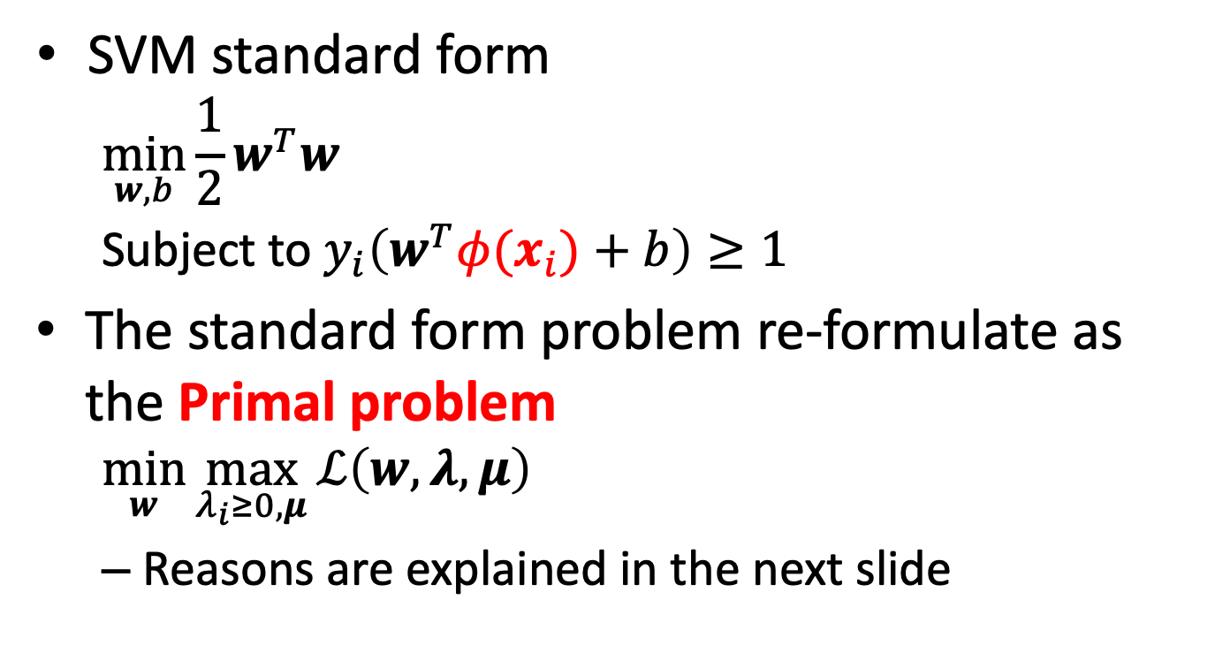
Primal form (1/2)
SVM standard form
$$\min_{w,b}{{\frac{1}{2}w}^{T}w}$$
Subject to $y_{i}\left(w^{T}φ(x_{i})+b\right)≥1$
The standard form problem re-formulate as the Primal problem
$$\min_{w}{\max_{λ_{i}≥0, μ}{ℒ\left(w,λ,μ\right)}}$$
Reasons are explained in the next slide

Slide 31
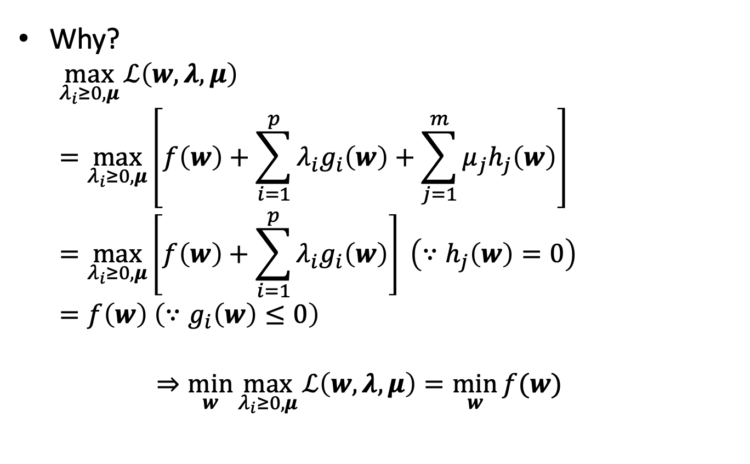
Primal form (2/2)
Why?
$$\max_{λ_{i}≥0, μ}{ℒ\left(w,λ,μ\right)} \\ =\max_{λ_{i}≥0, μ}\left[f\left(w\right)+\sum_{i=1}^{p}{λ_{i}g_{i}\left(w\right)}+\sum_{j=1}^{m}{μ_{j}h_{j}\left(w\right)}\right] \\ =\max_{λ_{i}≥0, μ}\left[f\left(w\right)+\sum_{i=1}^{p}{λ_{i}g_{i}\left(w\right)}\right]{ \left(∵h_{j}\left(w\right)=0\right)} \\ =f\left(w\right) \left(∵g_{i}\left(w\right)≤0\right)$$
$$⇒\min_{w}{\max_{λ_{i}≥0, μ}{ℒ\left(w,λ,μ\right)}}=\min_{w}{f(w)}$$

Slide 32
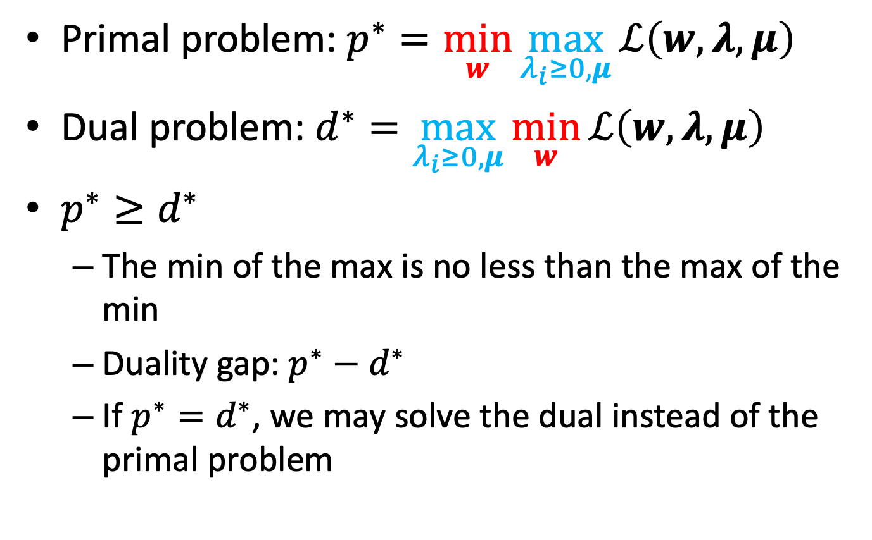
Primal vs dual problem
Primal problem: $p^{∗}=\min_{w}{\max_{λ_{i}≥0, μ}{ℒ\left(w,λ,μ\right)}}$
Dual problem: $d^{∗}=\max_{λ_{i}≥0, μ}{\min_{w}{ℒ\left(w,λ,μ\right)}}$
$p^{∗}≥d^{∗}$
The min of the max is no less than the max of the min
Duality gap: $p^{∗}−d^{∗}$
If $p^{∗}=d^{∗}$, we may solve the dual instead of the primal problem

Slide 33
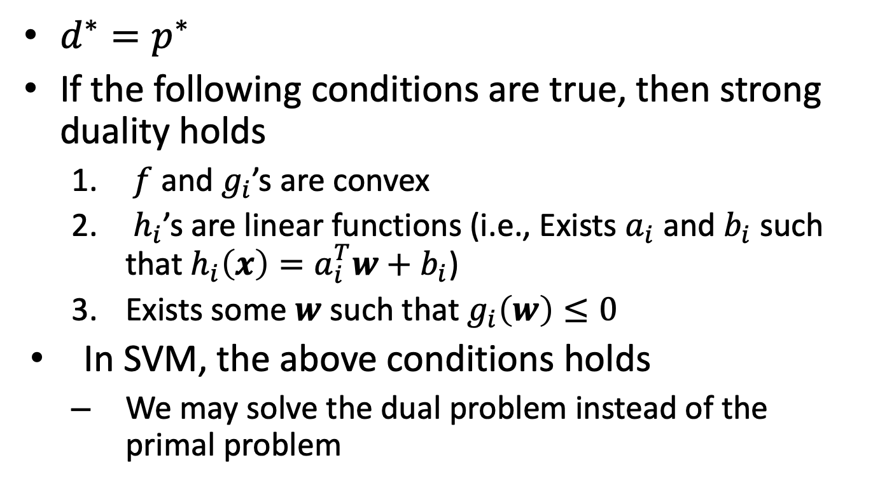
Strong duality
$d^{∗}=p^{∗}$
If the following conditions are true, then strong duality holds
$f$ and $g_{i}$’s are convex
$h_{i}$’s are linear functions (i.e., Exists $a_{i}$ and $b_{i}$ such that $h_{i}\left(x\right)=a_{i}^{T}w+b_{i}$)
Exists some $w$ such that $g_{i}\left(w\right)≤0$
In SVM, the above conditions holds
We may solve the dual problem instead of the primal problem

Slide 34
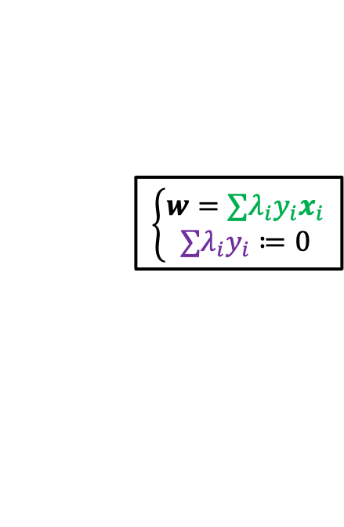
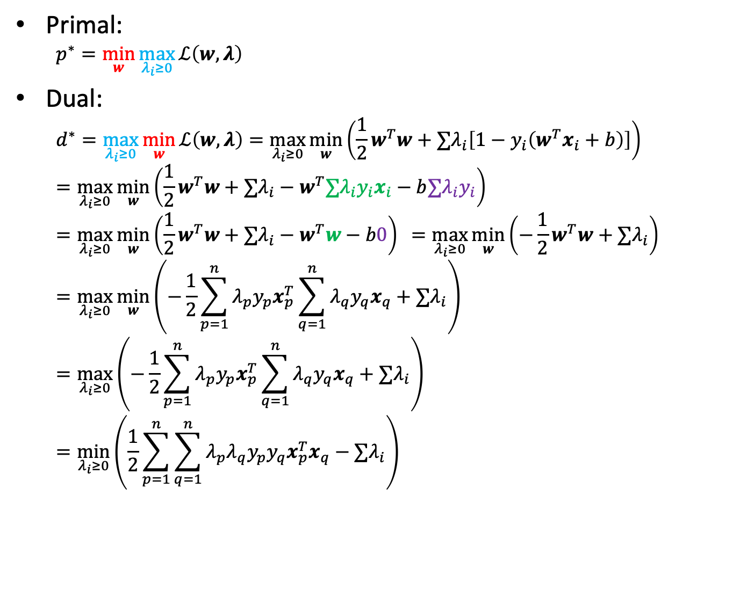
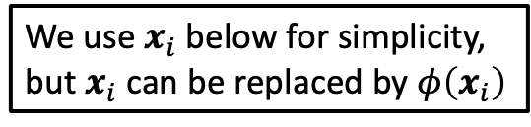
Primal and dual problem in SVM
Primal:
$$p^{∗}=\min_{w}{\max_{λ_{i}≥0}{ℒ\left(w,λ\right)}}$$
Dual:
$$d^{∗}=\max_{λ_{i}≥0}{\min_{w}{ℒ\left(w,λ\right)}}=\max_{λ_{i}≥0}{\min_{w}\left(\frac{1}{2}w^{T}w+∑λ_{i}\left[1−y_{i}\left(w^{T}x_{i}+b\right)\right]\right)}=\max_{λ_{i}≥0}{\min_{w}\left(\frac{1}{2}w^{T}w+∑λ_{i}−w^{T}∑λ_{i}y_{i}x_{i}−b∑λ_{i}y_{i}\right)} \\ =\max_{λ_{i}≥0}{\min_{w}\left(\frac{1}{2}w^{T}w+∑λ_{i}−w^{T}w−b0\right){ }}=\max_{λ_{i}≥0}{\min_{w}\left(−\frac{1}{2}w^{T}w+∑λ_{i}\right)}=\max_{λ_{i}≥0}{\min_{w}\left(−\frac{1}{2}\sum_{p=1}^{n}{λ_{p}y_{p}x_{p}^{T}}\sum_{q=1}^{n}{λ_{q}y_{q}x_{q}}+∑λ_{i}\right)}$$
$$=\max_{λ_{i}≥0}\left(−\frac{1}{2}\sum_{p=1}^{n}{λ_{p}y_{p}x_{p}^{T}}\sum_{q=1}^{n}{λ_{q}y_{q}x_{q}}+∑λ_{i}\right)=\min_{λ_{i}≥0}\left(\frac{1}{2}\sum_{p=1}^{n}{\sum_{q=1}^{n}{λ_{p}λ_{q}y_{p}y_{q}x_{p}^{T}x_{q}}}−∑λ_{i}\right)$$
We use $x_{i}$ below for simplicity, but $x_{i}$ can be replaced by $φ\left(x_{i}\right)$
$$\left\{\begin{aligned}w=∑λ_{i}y_{i}x_{i} \\ ∑λ_{i}y_{i}≔0\end{aligned}\right.$$

Slide 35
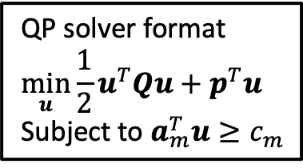
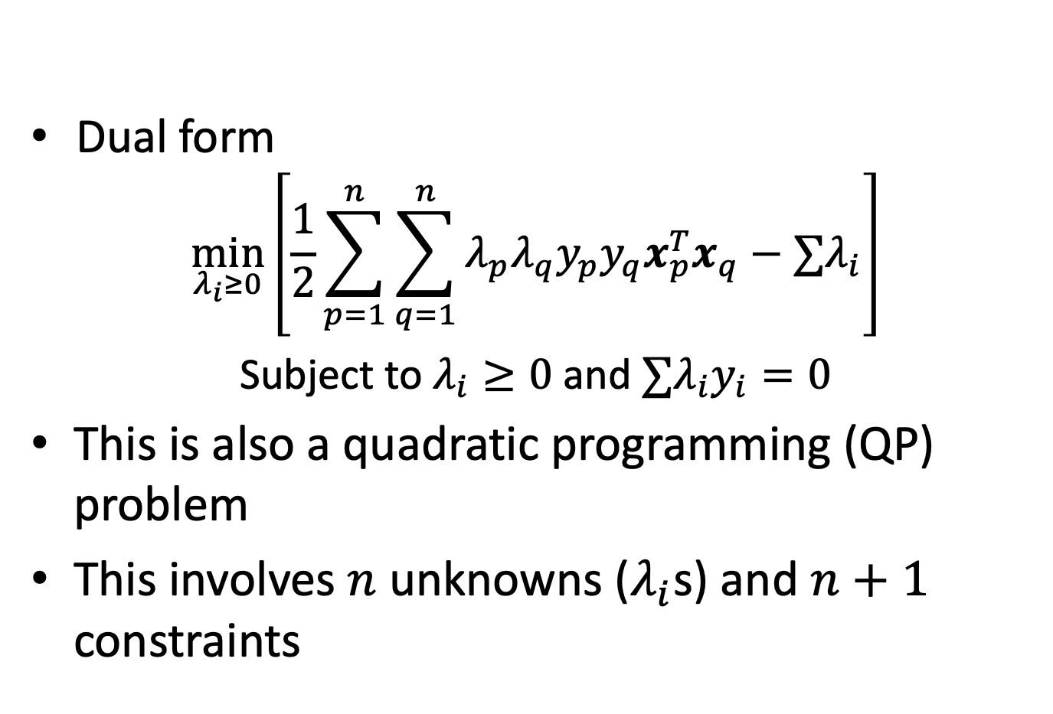
The dual problem
QP solver format
$$\min_{u}{{\frac{1}{2}u}^{T}Qu+p^{T}u}$$
Subject to $a_{m}^{T}u≥c_{m}$
Dual form
$$\min_{λ_{i}≥0}\left[\frac{1}{2}\sum_{p=1}^{n}{\sum_{q=1}^{n}{λ_{p}λ_{q}y_{p}y_{q}x_{p}^{T}x_{q}}}−∑λ_{i}\right]$$
Subject to $λ_{i}≥0$ and $∑λ_{i}y_{i}=0$
This is also a quadratic programming (QP) problem
This involves $n$ unknowns ($λ_{i}$s) and $n+1$ constraints

Slide 36
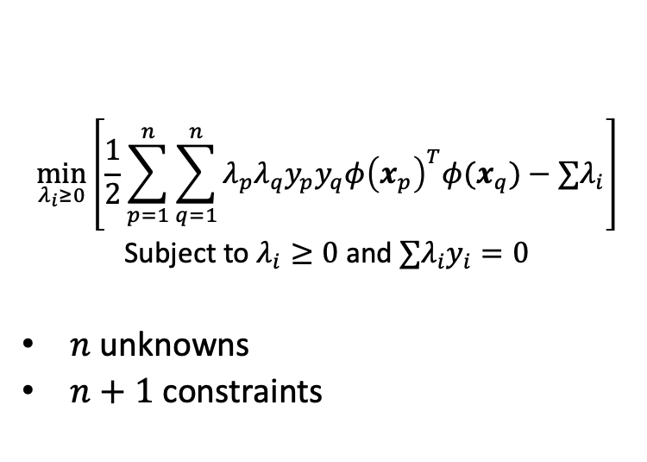
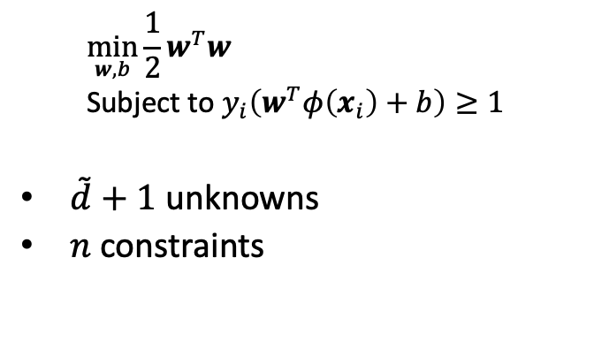
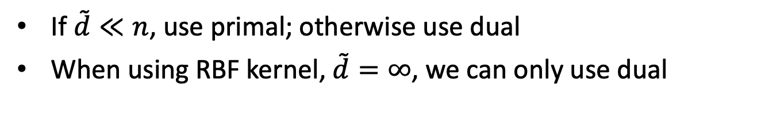
Primal vs dual
Primal
Dual
$$\min_{w,b}{{\frac{1}{2}w}^{T}w}$$
Subject to $y_{i}\left(w^{T}φ\left(x_{i}\right)+b\right)≥1$
$\tilde{d}+1$ unknowns
$n$ constraints
$$\min_{λ_{i}≥0}\left[\frac{1}{2}\sum_{p=1}^{n}{\sum_{q=1}^{n}{λ_{p}λ_{q}y_{p}y_{q}φ{\left(x_{p}\right)}^{T}φ(x_{q}})}−∑λ_{i}\right]$$
Subject to $λ_{i}≥0$ and $∑λ_{i}y_{i}=0$
$n$ unknowns
$n+1$ constraints
If $\tilde{d}≪n$, use primal; otherwise use dual
When using RBF kernel, $\tilde{d}=∞$, we can only use dual

Slide 37
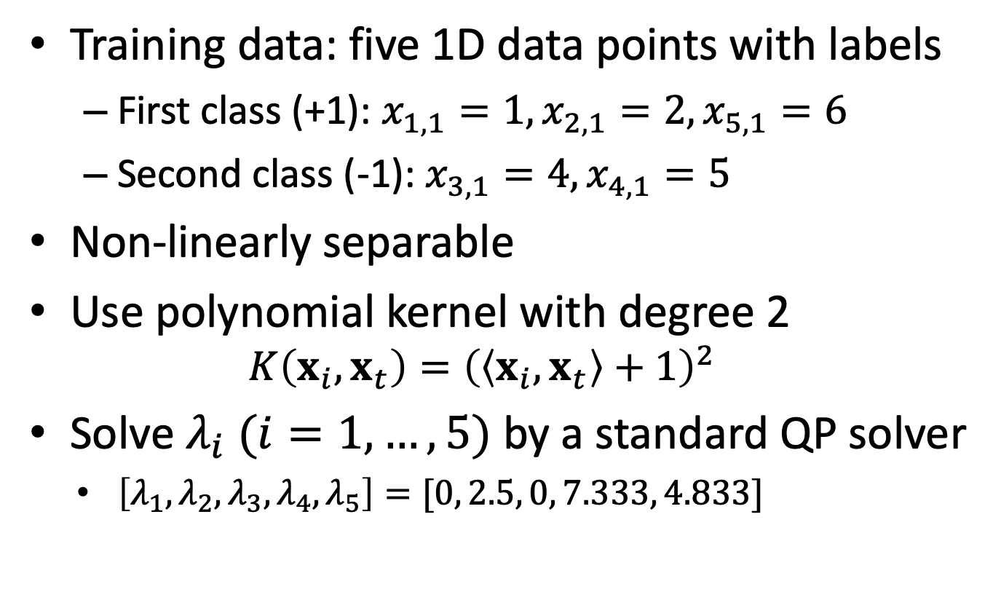
A numerical example
Training data: five 1D data points with labels
First class (+1): $x_{1,1}=1, x_{2,1}=2, x_{5,1}=6$
Second class (-1): $x_{3,1}=4, x_{4,1}=5$
Non-linearly separable
Use polynomial kernel with degree 2
$$K\left(x_{i},x_{t}\right)={\left(\left\langle x_{i},x_{t}\right\rangle +1\right)}^{2}$$
Solve $λ_{i} (i=1,…,5)$ by a standard QP solver
$\left[λ_{1},λ_{2},λ_{3},λ_{4},λ_{5}\right]=[0, 2.5, 0, 7.333, 4.833]$

Slide 38

The discriminant function of the example
$\left[λ_{1},λ_{2},λ_{3},λ_{4},λ_{5}\right]=[0, 2.5, 0, 7.333, 4.833]$
Since $λ_{1}=λ_{3}=0,$the support vectors are $\left(x_{2}, x_{4}, x_{5}\right)=(2, 5, 6)$
The discriminant function
$f\left(z\right)=∑λ_{i}y_{i}φ{\left(x_{i}\right)}^{T}φ\left(z\right)+b$ $=\left[2.5\left(1\right){\left(2z+1\right)}^{2}+7.333\left(−1\right){\left(5z+1\right)}^{2} \right.$
$\left.+4.833\left(1\right){\left(6z+1\right)}^{2}\right]+b$ $=0.6667z^{2}−5.333z+b$
Since $f\left(x_{2,1}\right)=f\left(x_{5,1}\right)=1$ and $f\left(x_{4,1}\right)=−1$, we can get b=9
$f\left(z\right)=0.6667z^{2}−5.333z+9$

Slide 39

Visualize the discriminant function
Support vectors

Slide 40

Standard SVM
Standard form
$$\min_{w,b}{{\frac{1}{2}w}^{T}w}+C\sum_{i}{ξ_{i}}$$
Subject to (1) $y_{i}\left(w^{T}φ(x_{i})+b\right)≥1−ξ$
(2) $ξ_{i}>0 ∀i$

Slide 41

Review of SVM
Large margin
Prevent overfitting
Soft margin
Make the margin become larger
Prevent overfitting
Kernel trick
Make the data linearly separable
Efficiently compute the inner product of “high-dimensional” features $φ{\left(x_{i}\right)}^{T}φ\left(x_{j}\right)$
Primal vs dual
# unknowns goes from $\tilde{d}+1$ to $n$
Use dual if $\tilde{d}≫n$

Slide 42
Revisiting logistic regression and SVM from another perspective

Slide 43
Deriving SVM and LogReg from regularized linear classification
We derived SVM from the viewpoint of maximal margin
We derived logistic regression from maximizing the log-likelihood (or minimizing the cross entropy loss)
However, both can be considered from the viewpoint of regularized linear classification

Slide 44

Regularized linear classification
Training data:
$${\left\{x_{i},y_{i}\right\}}_{i=1,…,n}, x_{i}∈R^{d},y_{i}∈\left\{±1\right\}$$
Objective
$$\min_{w}{f\left(w\right)},f\left(w\right)≡\frac{w^{T}w}{2}+C\sum_{i=1}^{n}{ξ\left(w;x_{i},y_{i}\right)}$$
$ξ\left(w;x_{i},y_{i}\right)$: loss function; we hope $y_{i}w^{T}x>0$
Trying to fit the training data
$\left(w^{T}w\right)/2$: regularization term
We skip the L1 regularization term here
Prevent over-fit the training data
C: regularization parameter

Slide 45

Loss functions
Common loss functions in classification
Hinge loss
$ξ_{L1}\left(w;x_{i},y_{i}\right)=\max\left(0, 1−y_{i}w^{T}x_{i}\right)$
Squared hinge loss
$ξ_{L2}\left(w;x_{i},y_{i}\right)={\max\left(0, 1−y_{i}w^{T}x_{i}\right)}^{2}$
Logistic loss
$ξ_{LR}\left(w;x_{i},y_{i}\right)=\log\left(1+e^{−y_{i}w^{T}x_{i}}\right)$
This is different from what we derived previously
We used 1/0 to encode two classes before, but here we use +1/-1
SVM: $ξ_{L1}$
Logistic Regression: $ξ_{LR}$

Slide 46

Visualizing the loss functions
$$ε=1$$

Slide 47


Regularization
L1
L2
${\left\|w\right\|}_{1}$
Non-differentiable
Sparse solution; possibly many zeros
Feature selection
Less storage of $w$
${w^{T}w}/2$
Smooth; easier to optimize

Slide 48

Regularized linear classification with kernel
Training data:
$${\left\{x_{i},y_{i}\right\}}_{i=1,…,m}, x_{i}∈R^{n},y_{i}∈\left\{±1\right\}$$
Objective
$$\min_{w}{f\left(w\right)},f\left(w\right)≡\frac{w^{T}w}{2}+C\sum_{i=1}^{m}{ξ\left(w;φ\left(x_{i}\right),y_{i}\right)}$$
$ξ\left(w;φ\left(x_{i}\right),y_{i}\right)$: loss function; we hope $y_{i}w^{T}φ\left(x_{i}\right)>0$
Trying to fit the training data
$w^{T}w/2$: regularization term
We skip the L1 regularization term here
Prevent over-fit the training data
C: regularization parameter

Slide 49
Logistic regression vs SVM
Logistic regression and SVM are very related
Their performance (i.e., test accuracy) is usually similar
Due to the naming, the typical deriving process, and historical reasons, many believe that SVM and logistic regression are very different
This is a misunderstanding

Slide 50

Linear or kernel? SVM or Logistic Regression?
When people say SVM, they typically mean “kernel SVM”
But there is linear SVM
$$\min_{w}{f\left(w\right)},f\left(w\right)≡\frac{w^{T}w}{2}+C\sum_{i=1}^{m}{\max\left(0, 1−y_{i}w^{T}x_{i}\right) }$$
When people say logistic regression, they typically mean “linear logistic regression”
But there is kernel logistic regression
$$\min_{w}{f\left(w\right)},f\left(w\right)≡\frac{w^{T}w}{2}+C\sum_{i=1}^{m}{\log\left(1+e^{−y_{i}w^{T}φ\left(x_{i}\right) }\right) }$$
However, kernel logistic regression is rarely used in practice
Most $λ_{i}$ are not zero ➔ if we want to apply the kernel trick (instead of storing w explicitly), almost all training samples need to be memorized

Slide 51

Regularized linear regression
Training data:
$${\left\{x_{i},y_{i}\right\}}_{i=1,…,m}, x_{i}∈R^{n},y_{i}∈R^{1}$$
Objective
$$\min_{w}\left(\frac{w^{T}w}{2}+C\sum_{i=1}^{m}{ξ\left(w;x_{i},y_{i}\right)}\right)$$
$ξ\left(w;x_{i},y_{i}\right)$: loss function
Trying to fit the training data
$w^{T}w/2$: regularization term
We skip the L1 regularization term here
Prevent over-fit the training data
C: regularization parameter

Slide 52

Loss functions for regression
Some commonly used loss functions
L1 loss
$ξ_{L1}\left(w;x_{i},y_{i}\right)=\left|y_{i}−w^{T}x_{i}\right|$
L2 loss
$ξ_{L2}\left(w;x_{i},y_{i}\right)={\left(y_{i}−w^{T}x_{i}\right)}^{2}$
$ε$-insensitive loss
$ξ_{ε}\left(w;x_{i},y_{i}\right)=\max\left(\left|w^{T}x_{i}−y_{i}\right|−ε, 0\right)$
$ε$-insensitive square loss
$ξ_{ε2}\left(w;x_{i},y_{i}\right)={\max\left(\left|w^{T}x_{i}−y_{i}\right|−ε, 0\right)}^{2}$
SVM (support vector regression): $ξ_{ε}$, $ξ_{ε2}$
Linear Regression: $ξ_{L2}$

Slide 53

Visualizing the loss functions
$$ε=1$$

Slide 54

Regularized regression with kernel
Training data:
$${\left\{x_{i},y_{i}\right\}}_{i=1,…,m}, x_{i}∈R^{n},y_{i}∈R^{1}$$
Objective
$$\min_{w}{f\left(w\right)},f\left(w\right)≡\frac{w^{T}w}{2}+C\sum_{i=1}^{m}{ξ\left(w;φ\left(x_{i}\right),y_{i}\right)}$$
$ξ\left(w;φ\left(x_{i}\right),y_{i}\right)$: loss function
Trying to fit the training data
$w^{T}w/2$: regularization term
We skip the L1 regularization term here
Prevent over-fit the training data
C: regularization parameter

Slide 55
Summary
The same classification method can be derived from different ways
SVM
Maximize margin
Minimizing training loss with regularization constraints
LR
Maximize log-likelihood
Minimizing training loss with regularization constraints
Linear regression and support vector regression are also under the same umbrella
Understanding the concept of training loss and regularization enables you to self-study many machine learning techniques

Slide 56

Quiz
What are “support vectors” of SVM?
When increasing training samples, will the size of “logistic regression model” increase?
When increasing training samples, will the size of “linear SVM model” increase?
When increasing training samples, will the size of “kernel SVM model” increase?
What is “kernel trick”
Compare the similarity and differences of logistic regression and support vector machines, in terms of loss function and the dimensionality of $w$
What is “support vector regressor”?

